Slide 1
Analysis of the Security Vulnerabilities in Virtual Private Networks ______________________________________________ Atiqa Zafar & Zaryab Khan CS381 NETWORK SECURITY

Slide 2
VPN is a network that is constructed by using public wires — usually the Internet — to enable remote users to securely connect to a private network, such as a company's internal network.
Virtual
Private
Networks

Slide 3
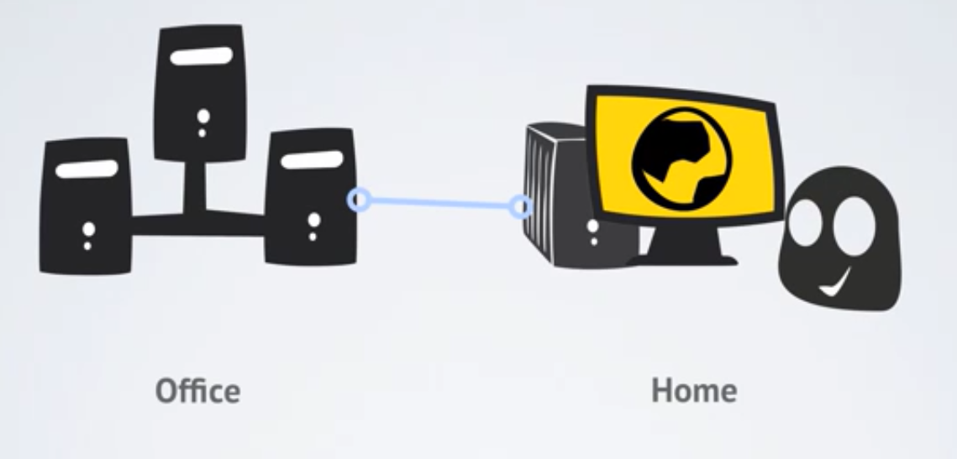
In the old days, VPN was used by corporate employees to access their offices while in remote when they needed to access sensitive information in a secure way.

Slide 4
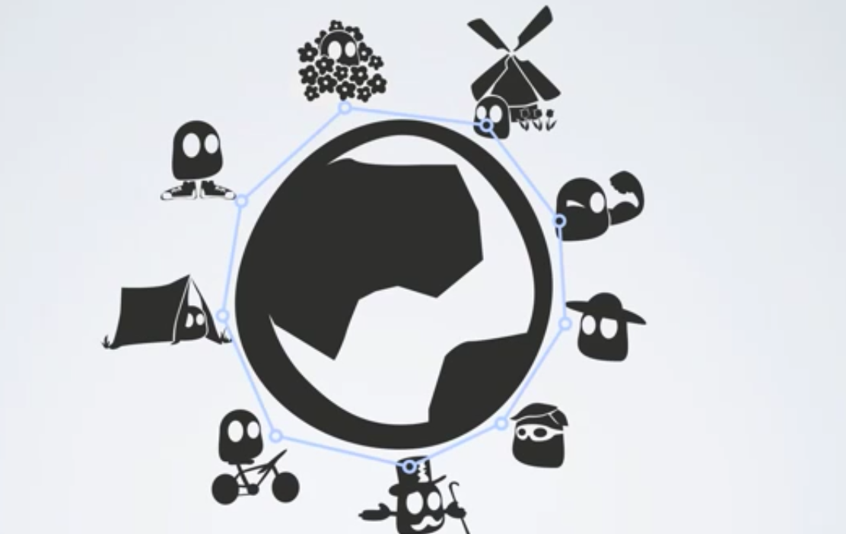
In time, VPN technology became available for regular internet users who connected from all over the world because VPN allowed them

Slide 5
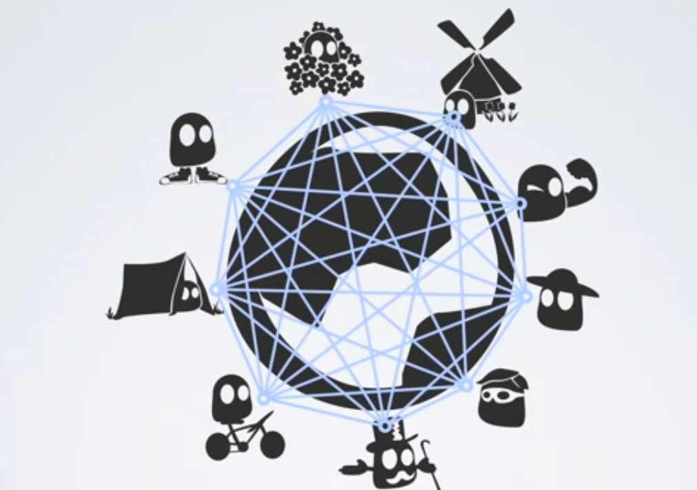
In time, VPN technology became available for regular internet users who connected from all over the world because VPN allowed them

Slide 6

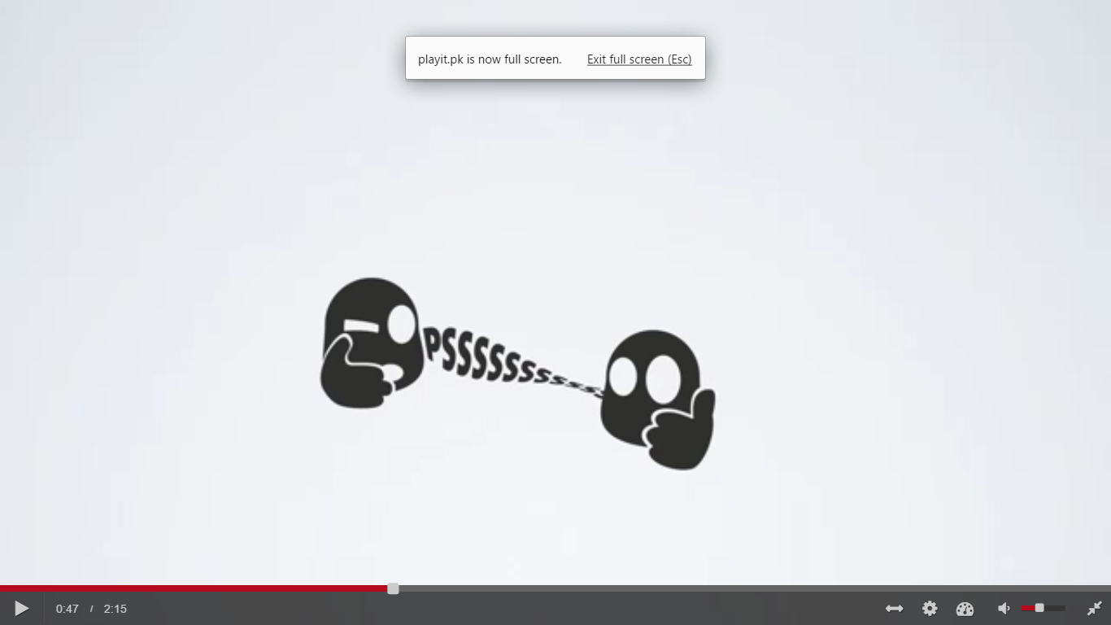
to encrypt the date, to become anonymous, to keep the traffic data private and safe from hackers, government censorships and other dangers on the internet, and to bypass geolocation restrictions by loging into a server located in a place where the content is available
ENCRYPTED
SECURE

Slide 7

to encrypt the date, to become anonymous, to keep the traffic data private and safe from hackers, government censorships and other dangers on the internet, and to bypass geolocation restrictions by loging into a server located in a place where the content is available
ANONYMITY

Slide 8

to encrypt the date, to become anonymous, to keep the traffic data private and safe from hackers, government censorships and other dangers on the internet, and to bypass geolocation restrictions by logging into a server located in a place where the content is available
PRIVACY
HACKERS
GOVT CENSORSHIP

Slide 9
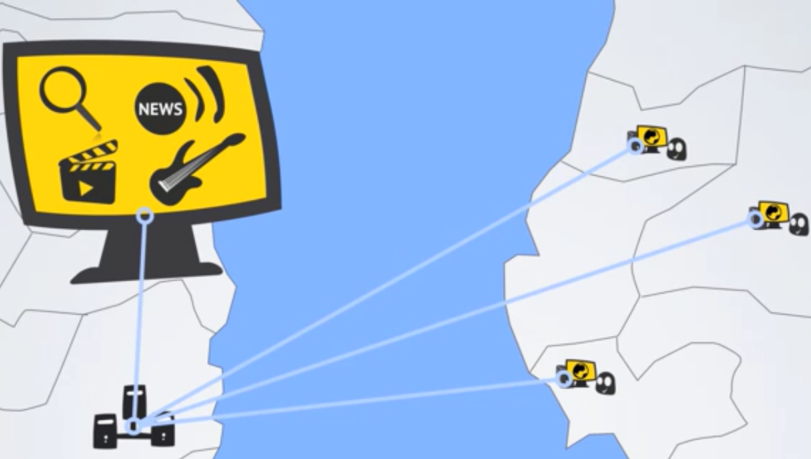
to bypass geolocation restrictions by logging into a server located in a place where the content is available
FREEDOM (ACCESS TO BLOCKED CONTENT)

Slide 10
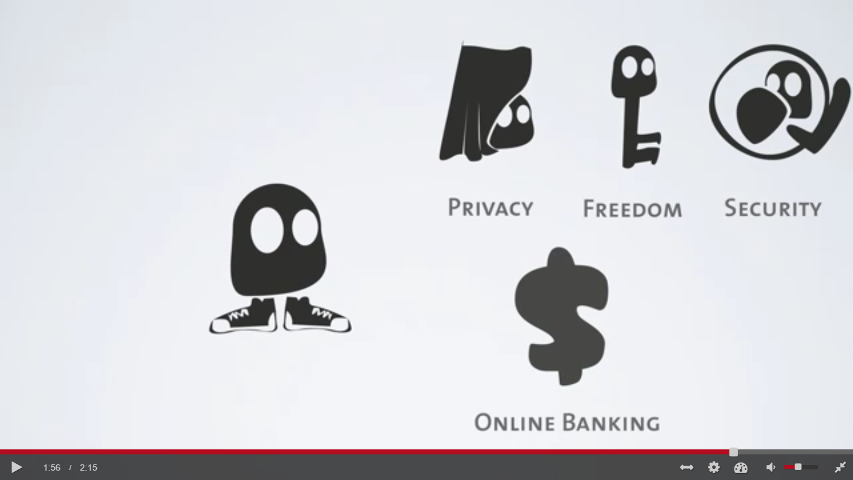
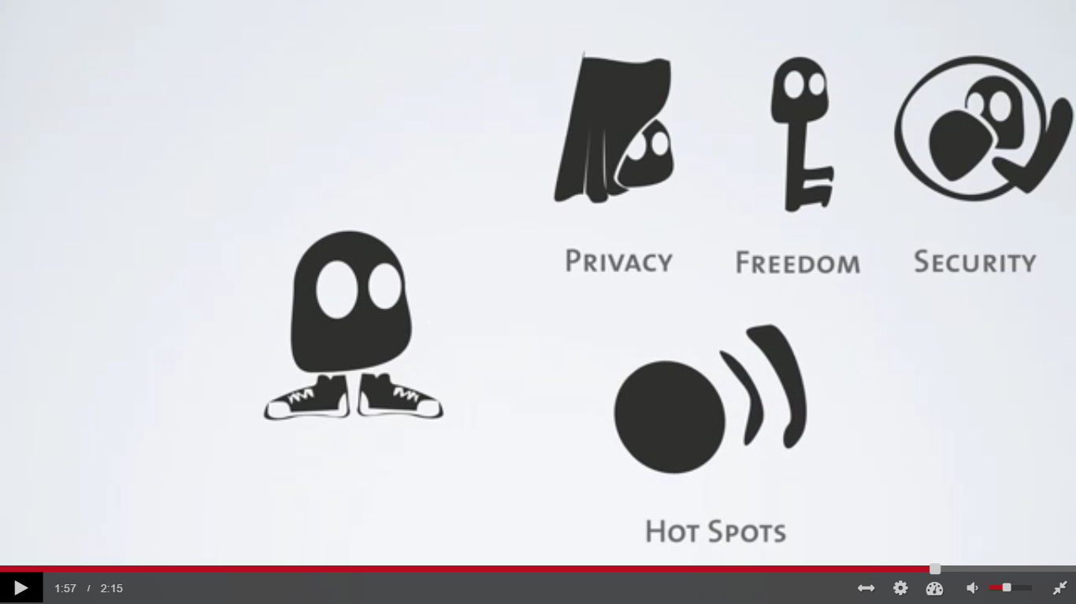
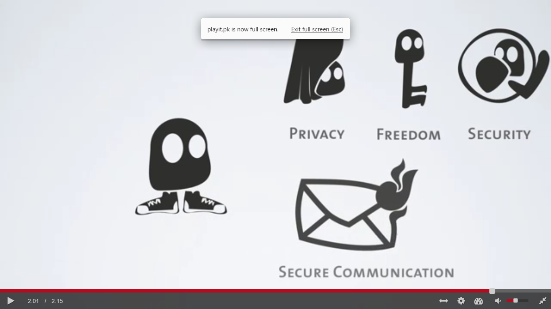
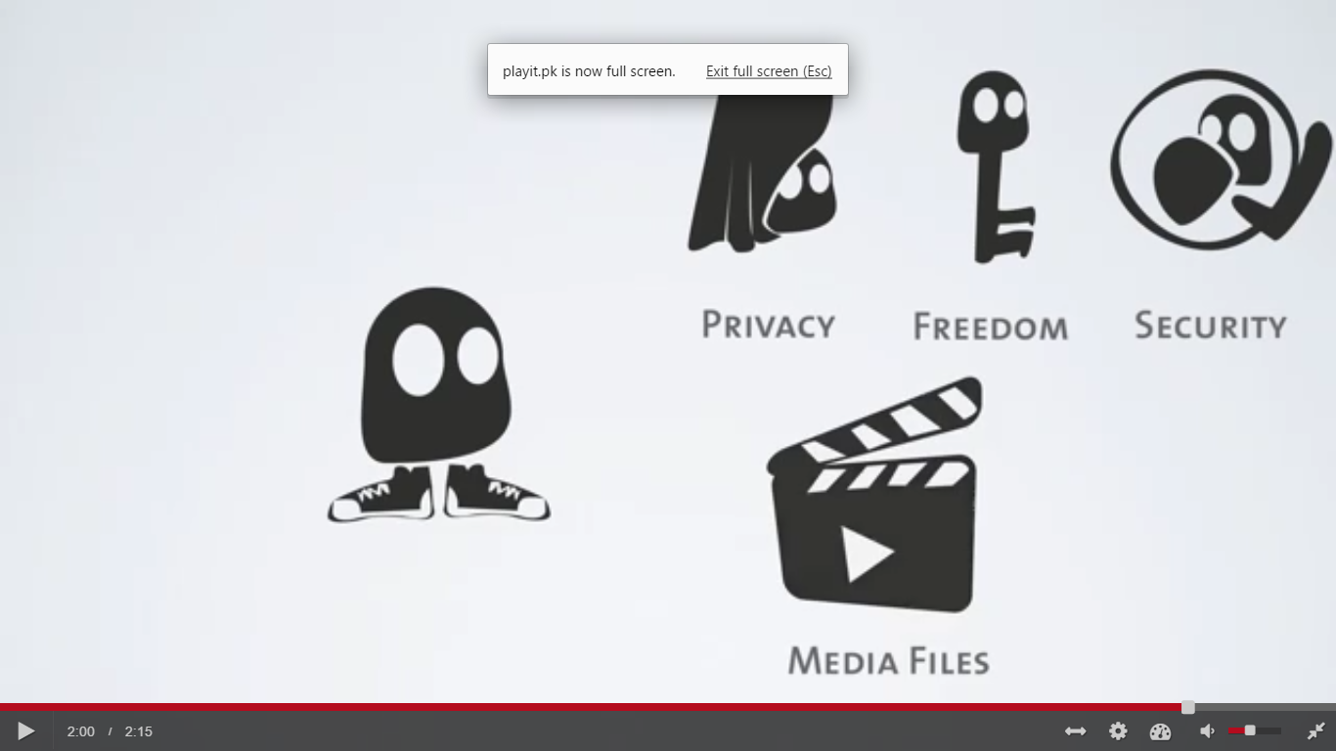
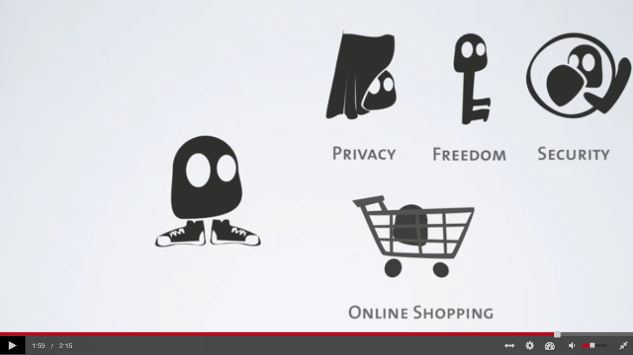
This is incredibly useful when you do your online banking, use Wi-Fi hotspots, shop online, access media or secure your communications
WIFI HOTSPOTS

Slide 11
Our motivation for this research project was
the increasing use of the VPN services by students, businesses and organizations
the large misinformation in product advertisements that they are exposed to (VPNs boldly claiming about privacy and anonymity without undergoing any standard evaluations not the impenetrable, secure systems )
open to attacks such as IPv6 leakage, DNS hijacking, Offline Password Cracking, Man-in-the-Middle Attacks and Malware Infections etc. Over half of the 16 VPN services, looked into by a group of researchers[19] from Sapienza University of Rome and Queen Mary University of London, used the Point-to-Point Tunneling Protocol with MS-CHAPv2 authentications, which makes them vulnerable to brute force hacks.
A worrying aspect of the problem is where people use VPN services for anonymity and security from government monitoring, little knowing that they are in fact fully exposing their data and online activity footprint.

Slide 12
Our motivation for this research project was
Therefore, in our research project, we aim to further evaluate the issue of User Anonymity, PPTP exploitation, IPv6 leakage, DNS hijacking and others to address the Security Risks of VPN in front of the student community. This way, we aim to create a more privacy conscious customer base that is able to choose secure technologies to meet their needs and that forces the VPN service providers to secure their services and clients against this risks.
Throughout our research, we also realized that the range of detection and defense practices to deal with the security vulnerabilities of VPNs have not been thoroughly provided. We aim to complement our analysis of the security vulnerabilities with a section on the countermeasures for VPN vulnerabilities.

Slide 13
Investigation of Potential Security Risks

Slide 14
#1 Compromise of User Anonymity
VPN service providers retain the user information.
prompt user to enter personal information,
(even a valid mobile number) at registration time.
retain timestamps, the amount of data transmitted,
and the client IP address of each VPN connection.

Slide 15
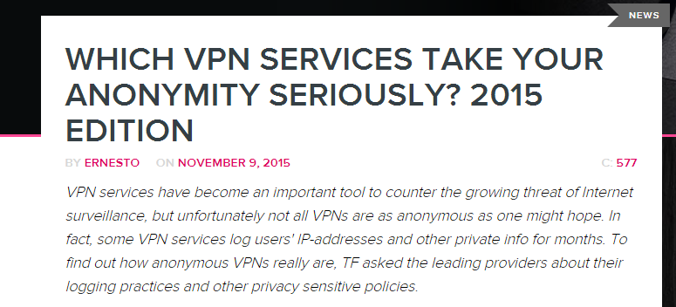
#1 Compromise of User Anonymity
VPN service providers retain the user information.
The TorrentFreak [13] has been interviewing the leading VPN providers about their logging practices for the four consecutive years (2012-15) [14-17] to figure out how anonymous VPNs truly are.

Slide 16
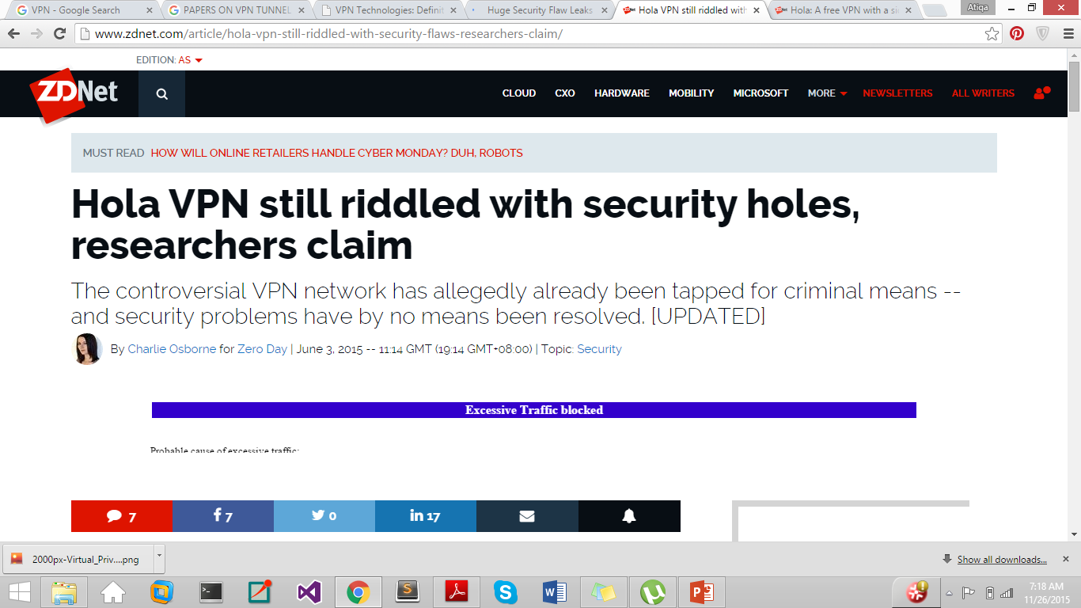
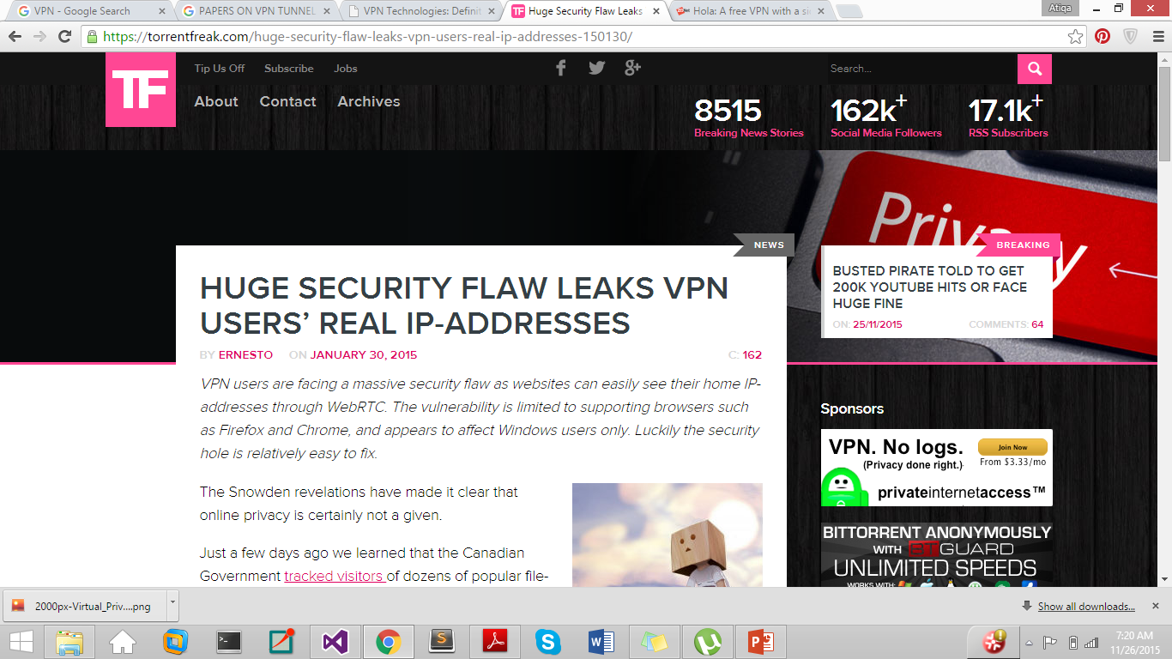
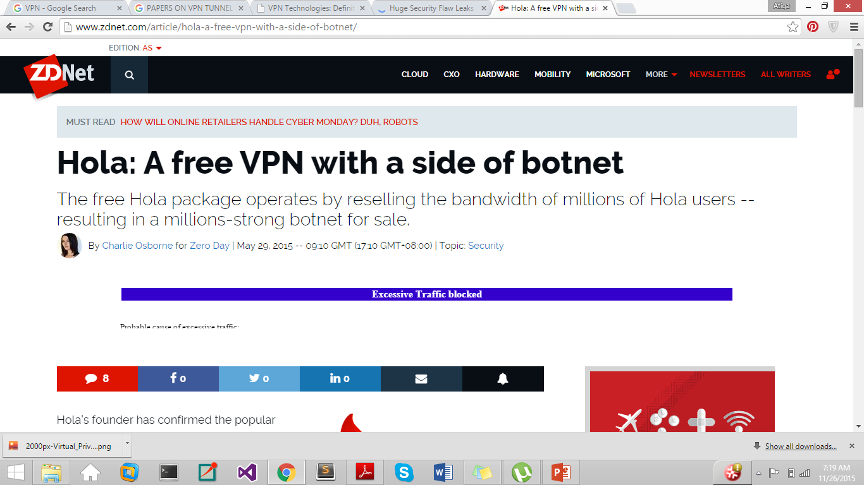
#1 Compromise of User Anonymity
VPN service providers retain the user information.
A number of cases have occurred where the VPN service providers have disclosed the user traffic. e.g. Israel-based Hola used by roughly 46 Million users was caught

Slide 17
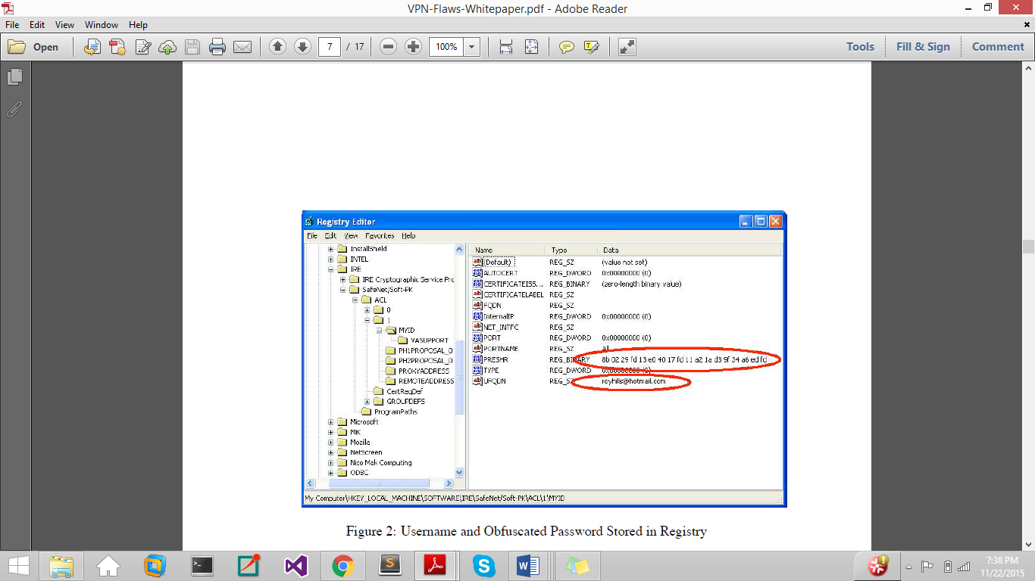
#1 Compromise of User Anonymity
VPN service providers retain the user information.
VPN client programs store the user authentication credentials on the client machine.
store the username unencrypted in a file or the registry with weak registry or file permissions for stored credentials and anyone with an access to the machine can obtain it. If the VPN is using IKE Aggressive Mode, then knowing the username can lead to an offline cracking attack against the password.
Even the password is stored on the client machine in a scrambled form that is often referred to as encryption.
Figure 3.2. Username and obfuscated password stored in the Registry.

Slide 18
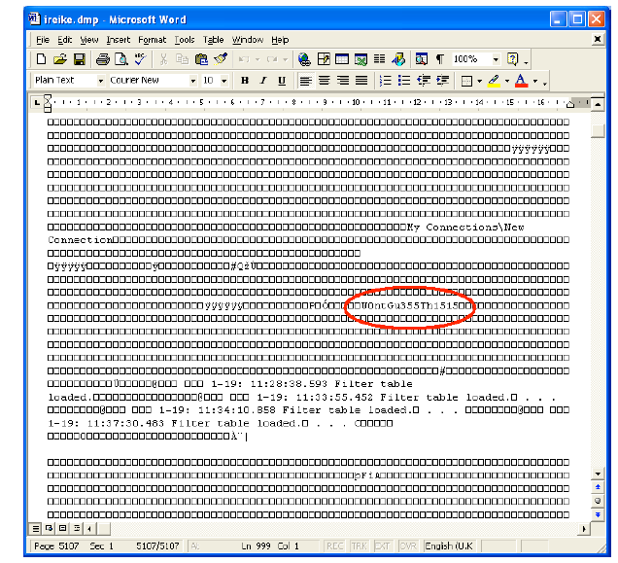
#1 Compromise of User Anonymity
VPN service providers retain the user information.
VPN client programs store the user authentication credentials on the client machine.
Many client programs also decrypt this obfuscated version of the password in file/registry when they start up, and store a plaintext version of the password in memory. starting the VPN client and dumping the process memory with a tool such as pmdump can leak the password.
Figure 3.3 shows a memory dump from a VPN client with the clear-text password W0ntGu355Th15 highlighted.

Slide 19
#2 Exploits in an IPsec VPN
IPsec based VPNs
Authentication Header (AH) protects IP packet header by calculating an encrypted checksum,
Encapsulating Security Payload (ESP) encrypts IP packet contents.
Internet Key Exchange (IKE) is crucial for AH and ESP – handles secure exchange of secret key.
Main Mode: Diffie-Hellman key exchange.
Aggressive: initiator and responder hashes pass in the clear
Pen-testing IPsec based VPNs
Scanning open ports and fingerprinting
PSK mode assessment and PSK sniffing
Username Enumeration Vulnerabilities
Offline Password Cracking

Slide 20
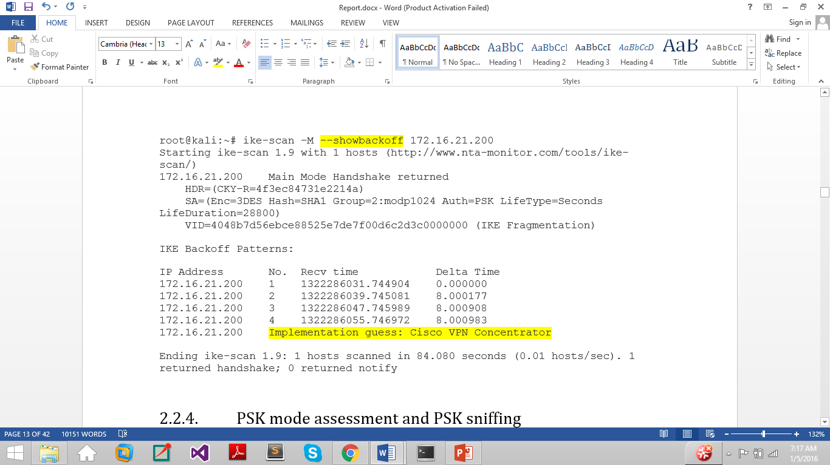
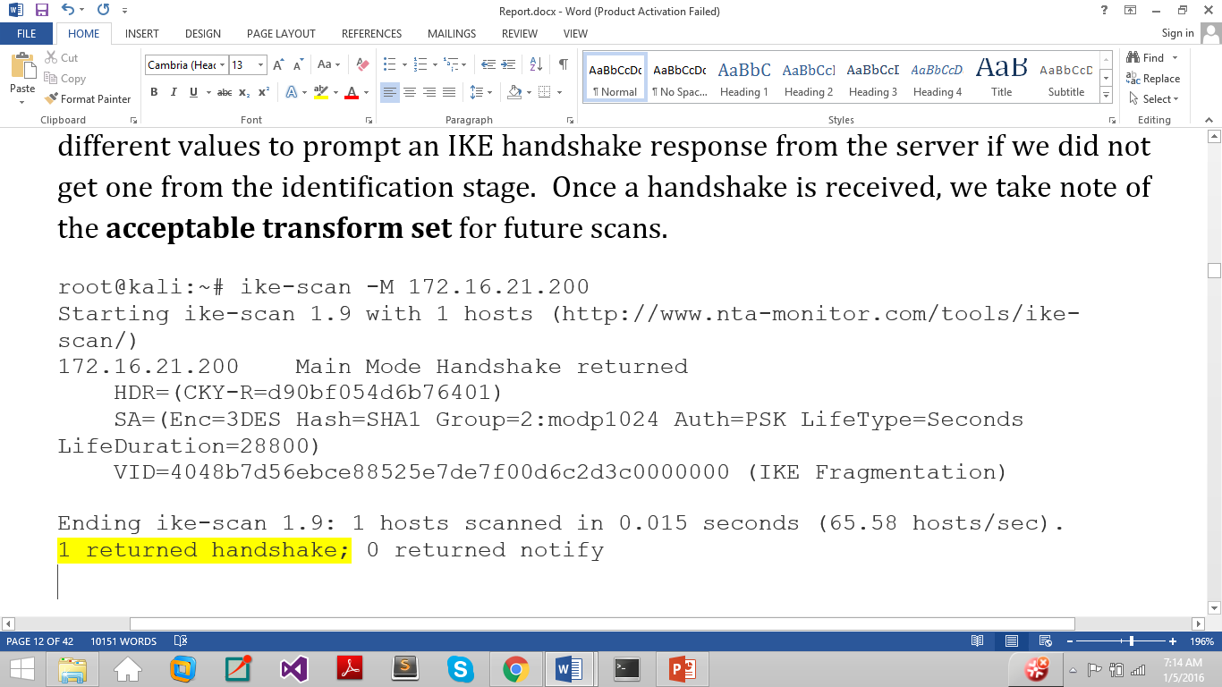
#2 Exploits in an IPsec VPN
Pen-testing IPsec based VPNs
Scanning open ports and fingerprinting
1) port-scan the target
2) fingerprint the VPN gateway for guessing implementation.
a) acceptable transform set
b) Back off Strategy
Port | Type of VPN Implementation
UDP 500 | IPsec
TCP 1723 | PPTP/L2TP
TCP 443 | SSL
Tools: Nmap, Ike-scan

Slide 21
#2 Exploits in an IPsec VPN
Pen-testing IPsec based VPNs
PSK mode assessment and PSK sniffing
Tools: IKE Probe or IKE Scan Tool to force the VPN server into the aggressive mode of IPsec from the main mode by trying out various transform set. This makes it possible to capture the authentication data and use a brute force or dictionary attack to recover the PSK.
AGGRESSIVE MODE
Client: IKE packet containing Identity payload
Server: reply IKE packet with Hash payload (HMAC hash of information including the pre-shared key).
Client: packet with Hash payload

Slide 22
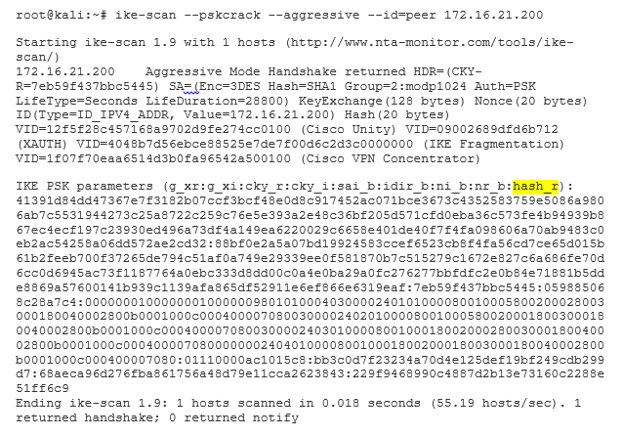
#2 Exploits in an IPsec VPN
Pen-testing IPsec based VPNs
PSK mode assessment and PSK sniffing
Tools: IKE Probe or IKE Scan Tool to force the VPN server into the aggressive mode of IPsec from the main mode by trying out various transform set. This makes it possible to capture the authentication data and use a brute force or dictionary attack to recover the PSK.

Slide 23
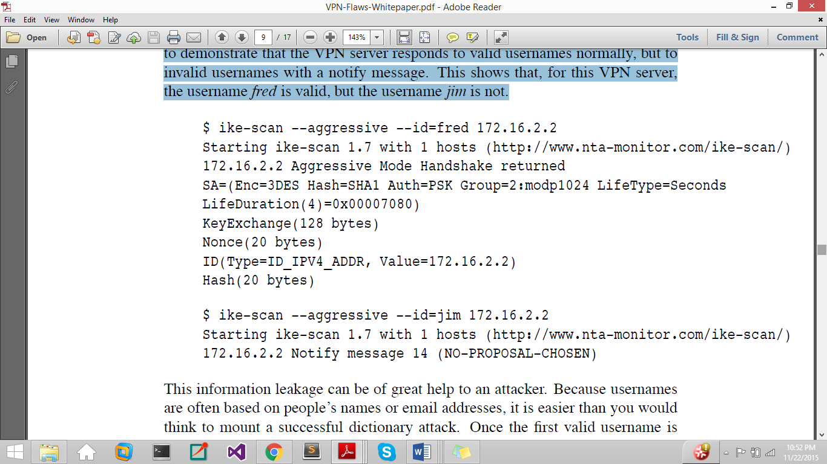
#2 Exploits in an IPsec VPN
Pen-testing IPsec based VPNs
Username Enumeration Vulnerabilities
response to an incorrect login attempt should not leak information about which of the authentication credentials (username or password) was incorrect, because this allows an attacker to deduce whether a given username is valid or not, leading to ease in dictionary attacks

Slide 24
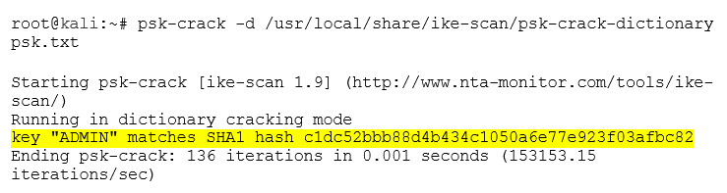
#2 Exploits in an IPsec VPN
Pen-testing IPsec based VPNs
Offline Password Cracking
Tools: MDCrack, PSK-CRACK
Given that a valid username has been obtained successfully, an attacker can crack the associated password by using the hash from the VPN Server
and, running a list of candidate passwords (keys) through the hash function and comparing the resulting hash in each case with the hash that the server sent.

Slide 25
#2 Exploits in an PPTP VPN
PPTP VPN
encapsulating packets inside point-to-point protocol (PPP) packets, which are in turn encapsulated in generic routing encapsulation protocol (GRE) packets
Authentication method: Microsoft challenge handshake authentication protocol (MS-CHAP v2)
Server: challenge
Client: uses this challenge and the password to calculate a response.
Server: checks the provided response against the response it expected.
PPTP Exploitation
MitM Attack to Sniff Challenge and Response Packets
Cracking MSCHAPv2

Slide 26
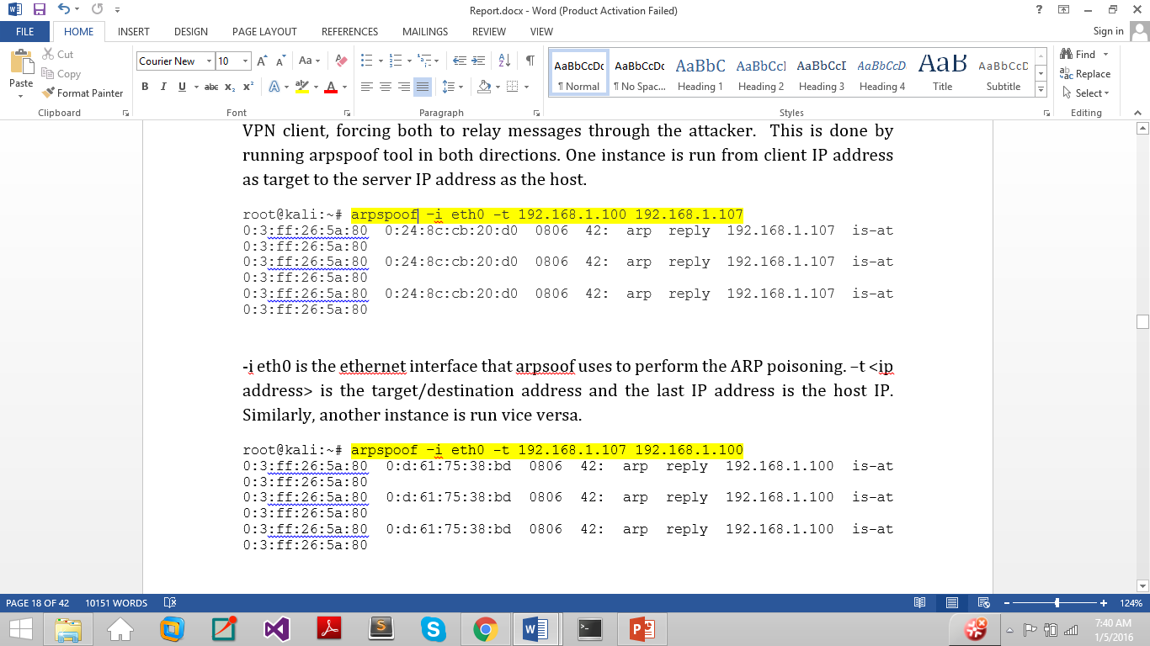
#2 Exploits in an PPTP VPN
PPTP Exploitation
MitM Attack to Sniff Challenge and Response Packets
1) ARP cache poisoning using ARPspoof

Slide 27
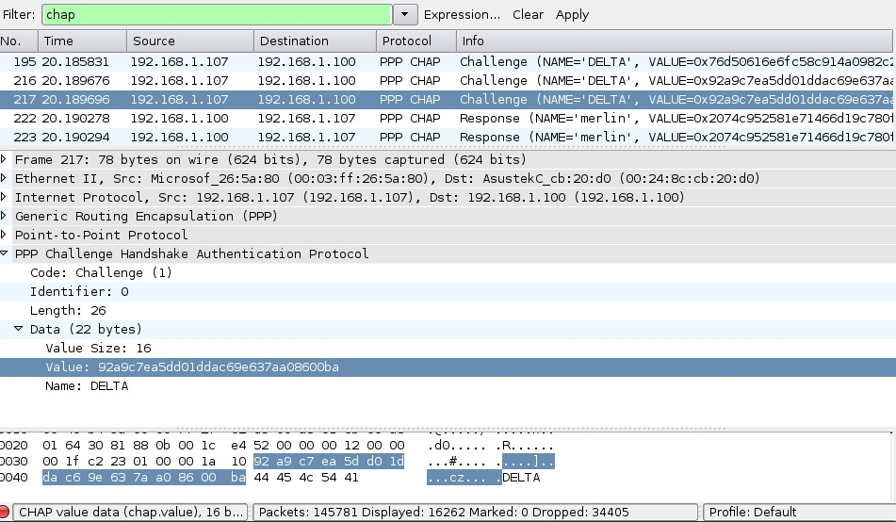
#2 Exploits in an PPTP VPN
PPTP Exploitation
MitM Attack to Sniff Challenge and Response Packets
2) Packet analysis using Wireshark to get CHAP hashes

Slide 28
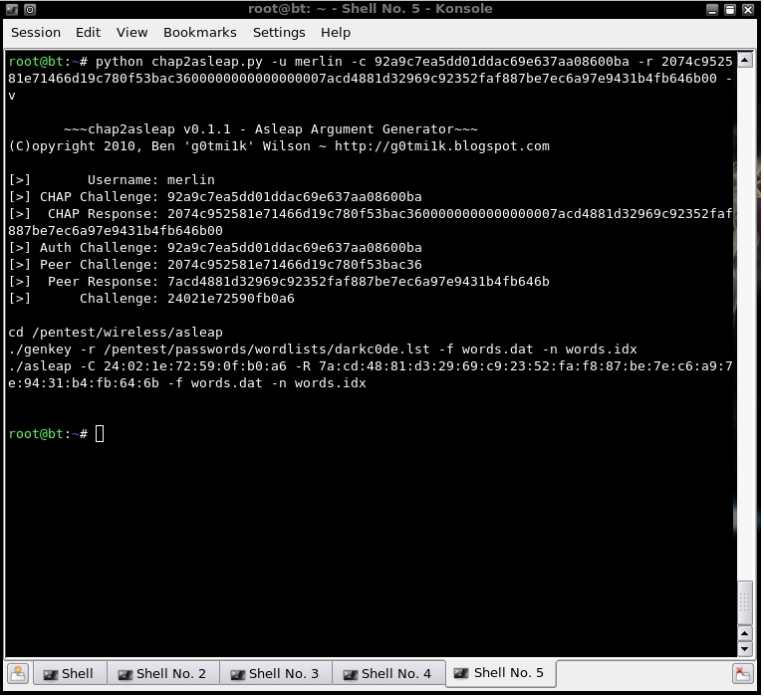
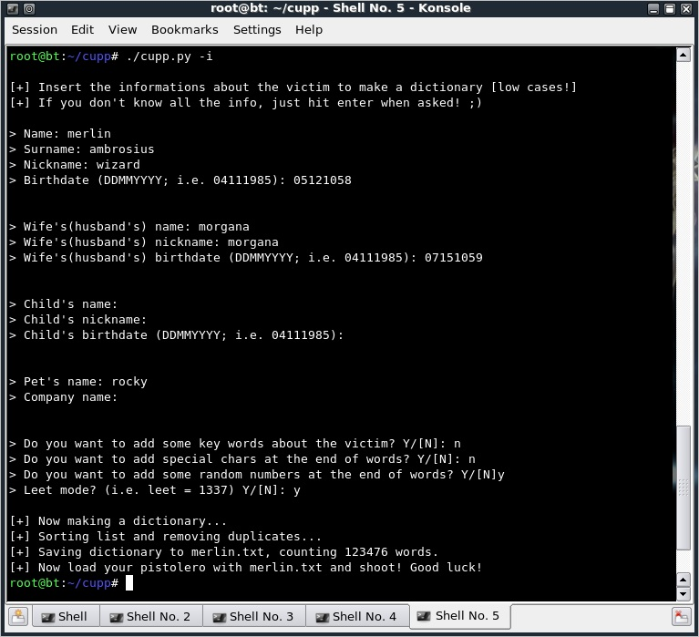
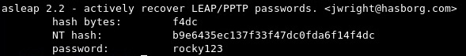
#2 Exploits in an PPTP VPN
PPTP Exploitation
Cracking MSCHAPv2
Formatting challenge and response values using chap2asleap
Producing Dictionary File using CUPP2
Cracking the password using ASLEAP

Slide 29
#2 Exploits in an PPTP VPN
PPTP Exploitation
Cracking MSCHAPv2
Formatting challenge and response values using chap2asleap
Producing Dictionary File using CUPP2
Cracking the password using ASLEAP

Slide 30
#2 Exploits in an PPTP VPN
PPTP Exploitation
Cracking MSCHAPv2
Formatting challenge and response values using chap2asleap
Producing Dictionary File using CUPP2
Cracking the password using ASLEAP

Slide 31
#3 IPv6 Leakage
Why does IPv6 leakage occur?
VPN client programs only manipulate the IPv4 routing table and not the IPv6 routing table, resulting in all IPv6 traffic bypassing (leaking out of) the VPN’s virtual interface
IPv4/6 dual stack implementations / most OS have IPv6 enabled and prefer it over IPv4 in line with RFC 6724
The SLAAC Attack
A man in the middle can advertise himself as an IPv6 router, and the VPN client OS will start sending all the traffic to him because IPv6 is preferred.
third party “plug-ins”
such as ad brokers, trackers, analytics tools, social media plugins, and the Referer HTTP header disclose the exact URL of the visited page in the fetching of each of the third party objects embedded in it. Even if one of these fetches are leaked through IPv6 traffic leakage outside the VPN tunnel, then the actual user IP can be compromised along with the page URL that the host is accessing.

Slide 32
#3 IPv6 Leakage
all desktop VPN client programs leak IPv6 Traffic except for Mullvad, VyprVPN and TorGuard (in Advanced Settings). As for mobile OS, Ios completely disables IPv6 during the VPN tunnel lifetime and thereby, all its VPN Services resist IPv6 Leakage. However, all VPN services on Android are vulnerable to the leakage.

Slide 33
#4 Routing Table Attacks
VPN Client program establishes a tunnel and modifies the host routing table in order to redirect all the traffic towards the virtual network interface created to encrypt and forward the traffic to the VPN remote entry point via the host’s active network interface (e.g., Wi-Fi or Ethernet). These steps initiate the tunnel fully to send all user traffic via the VPN in an encrypted form.
routing tables are a resource concurrently managed by the operating system,
None of the VPN Clients studied in [19] monitor the routing table to ensure that their initial configuration is not changed. Even small changes to the routing table, either malicious or accidental, results in traffic leakage beyond the VPN tunnel.

Slide 34
#5 DNS Hijacking
DNS Hijacking or DNS redirection is a more concentrated attack to transparently capture all DNS queries, both IPv4 and IPv6, from the VPN Client machine.
It is assumed that the adversary controls the network’s gateway, say the WiFi access point in all these attacks.
In the case of Default Configuration where the VPN Client keeps using its Existing DNS server as the default, the attack is simple to carry out, the adversary can simply use DHCP to set the client’s DNS server to the one under his control to redirect all DNS queries generated by the host to himself.
In the VPN-Managed configuration, the adversary redirects all DNS queries by modifying the routing table of client to make the DNS a local network resource, accessible directly via the LAN rather than through the VPN tunnel.

Slide 35
#5 DNS Hijacking
DNS Hijacking or DNS redirection is a more concentrated attack to transparently capture all DNS queries, both IPv4 and IPv6, from the VPN Client machine.
It is assumed that the adversary controls the network’s gateway, say the WiFi access point in all these attacks.
In the case of Default Configuration where the VPN Client keeps using its Existing DNS server as the default, the attack is simple to carry out, the adversary can simply use DHCP to set the client’s DNS server to the one under his control to redirect all DNS queries generated by the host to himself.
In the VPN-Managed configuration, the adversary redirects all DNS queries by
modifying the routing table of client to make the DNS a local network resource, accessible directly via the LAN rather than through the VPN tunnel.
producing a split tunnel and fooling the victim host into believing that the DNS is a local resource in the LAN.

Slide 36
COUNTERMEASURES

Slide 37
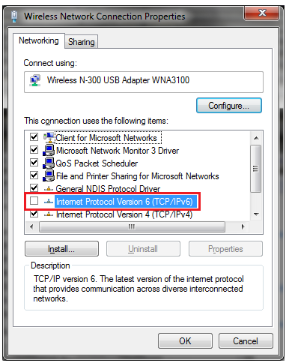
#1 Defense against IPv6 Leakage
disabling IPv6 traffic on the Client Machine (short term solution)
make VPN Client program reconfigure the IPv6 routing table as well so that both IPv4 and IPv6 traffic is securely sent through the VPN tunnel.
RFC6105 (published by the IETF) tells on how to deal with rogue router advertisements that exploit IPv6 traffic.
Man-in-the-Middle attacks can be detected (not defended) using Neighbor Discovery Protocol Monitor NDPMon (a diagnostic software application used by IPv6 network administrators for monitoring ICMPv6 packets to detect suspicious neighbor/router discovery traffic)

Slide 38
#1 Defense against IPv6 Leakage
The ultimately best way to defend against Man-in-the-Middle Attacks exploiting IPv6 is to ensure that the Client machine always has an IPv6 connection so that no attacker can misuse our default gateway. The MitM attack is possible because we are not trying to subvert an existing IPv6 network but injecting RAs onto a IPv6-capable IPv4 networks, not native IPv6 or dual stack ones.

Slide 39
#2 Defense against DNS Hijacking
DNS hijacking can be detected if the VPN Client periodically monitors the DNS Connection rather than just at the tunnel initiation.
The Client’s Routing Table should also be monitored for changes in the configuration.
DNS hijacking can be defended if we configure the VPN tunnel gateway to have the same IP Address as the DNS resolver. This prevents adversary from producing a split tunnel and fooling the victim host into believing that the DNS is a local resource in the LAN. This solution has been implemented in Astrill VPN and successfully prevent DNS queries to be redirected to the adversary.

Slide 40
#2 Defense against DNS Hijacking
Use a private DNS. Selecting a fake subnet is easy when a third party DNS service is being used. It becomes difficult when the VPN service provider uses its own private DNS as it ensures that the subnet contains at least three IPs (i.e., the DNS server, the gateway, and the VPN Client). However, the VPN is still at risk of route injection attack when OpenVPN is used with these configurations.

Slide 41
#3 Defense against Authentication Vulnerabilities
Strong authentication by means of certificates, smart cards or tokens can be used when users are connecting to the VPN Server.
A smart card stores a user profile, encryption keys and algorithms. A PIN number is usually required to invoke the smart card. A token card provides a one-time password. When the user authenticates correctly on the token by entering the correct PIN number, the card will display a one-time passcode that will allow access to the network.
Add-on authentication system, like TACACS+, RADIUS can be also used to create a profile of all VPN users, controlling the access to the private network.

Slide 42
FUTURE SCOPE

Slide 43
In future, the research can be extended by
experimentally verifying and evaluating these countermeasure techniques.
an evaluative study of the commercial VPNs currently popular in the local and global market can also be undertaken that discusses the detection and defense mechanisms they use to provide security and the risks they are currently unable to remove.

